Slide 1
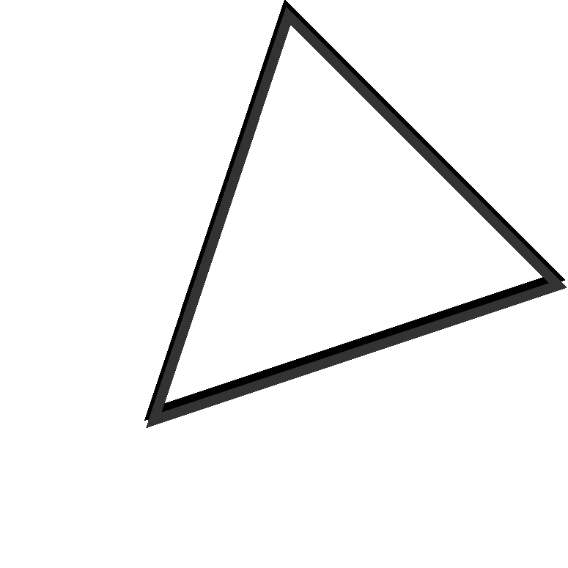
Thói quen
rèn luyện sức khoẻ của sinh viên
TRƯỜNG ĐẠI HỌC CÔNG NGHỆ THÔNG TIN-ĐHQG TP.HCM
Giảng viên: Thái Huy Tân

Slide 2



Thành viên trong nhóm
STEFFANI HOLIBURT
Chief Innovation Officer
AMARA UZBIEN
Chief of Design
GRAYSON BELAZZO
Chief Experience Officer
G I Ả N G V I Ê N : T H Á I H U Y T Â N

Slide 3

Nội dung thuyết trình
TOPIC OUTLINE
What is Design Thinking?
Rationale Practical Applications
Tools About ZimCore Hubs Meet Our Team
Z I M C O R E H U B S | D E S I G N T H I N K I N G

Slide 4


Giới thiệu đề tài
CHÚNG TA ĐÃ RÈN LUYỆN SỨC KHOẺ?
Presentations are communication tools that can be used as demonstrations, lectures, speeches, reports, and more. Most of the time, they’re presented before an audience. It serves a variety of purposes, making them powerful tools for convincing and teaching.
Z I M C O R E H U B S | D E S I G N T H I N K I N G

Slide 5
HÒ CHÍ MINH NÓI RẰNG:
WE CAN' T SOLVE PROBLEMS BY USING THE SAME KIND OF THINKING WE USED WHEN WE
CREATED THEM.
- ALBERT EINSTEIN

Slide 6


Tổng quan
IDEATE, PROTOTYPE, TEST, REPEAT
Presentations are communication tools that can be used as demonstrations, lectures, speeches, reports, and more. Most of the time, they’re presented before an audience. It serves a variety of purposes, making them powerful tools for convincing and teaching.

Slide 7

Hợp đồng nhóm
IT'S A PROCESS EVEN THE MOST TRADITIONAL THINKERS CAN ADOPT.
Z I M C O R E H U B S | D E S I G N T H I N K I N G

Slide 8






MỤC TIÊU
AVOID JUDGMENTS
Presentations are tools that can be used for different purposes.
AIM FOR QUALITY, NOT QUANTITY
Presentations are tools that can be used for different purposes.
ENCOURAGE WILD IDEAS
Presentations are tools that can be used for different purposes.

Slide 9


NÊN LÀM
Presentations are communication tools that can be used as demonstrations, lectures, speeches, reports, and more.
Nguyên tắc hoạt động
KHÔNG NÊN LÀM
Presentations are communication tools that can be used as demonstrations, lectures, speeches, reports, and more.
NÊN LÀM (KHÔNG BĂC BUOC)
Presentations are communication tools that can be used as demonstrations, lectures, speeches, reports, and more.
Z I M C O R E H U B S | D E S I G N T H I N K I N G

Slide 10

Kế hoạch giao tiếp nhóm
UNI4
THE E ARLY YEARS
Presentations are tools that can be used for different purposes.
INITIAL SUCCESSES
Presentations are tools that can be used for different purposes.
RISE TO MARKET LEADERSHIP
Presentations are tools that can be used for different purposes.
STUMBLING BLOCKS
Presentations are tools that can be used for different purposes.
REINVENTION AND GROWTH
Presentations are tools that can be used for different purposes.
Z I M C O R E H U B S | D E S I G N T H I N K I N G

Slide 11
Thực hiện khảo sát
IT'S A PROCESS EVEN THE MOST TRADITIONAL THINKERS CAN ADOPT.
Z I M C O R E H U B S | D E S I G N T H I N K I N G

Slide 12
Presentations are communication tools that can be used as demonstrations, lectures, speeches, reports, and more.
VIDEO KHẢO SÁT

Slide 13
Kết luận
IT'S A PROCESS EVEN THE MOST TRADITIONAL THINKERS CAN ADOPT.
Z I M C O R E H U B S | D E S I G N T H I N K I N G

Slide 14















Free Resources
USE THESE FREE, RECOLOURABLE ICONS AND ILLUSTRATIONS IN YOUR CANVA DESIGN.

Slide 15


COMPANIES USING DESIGN THINKING APPROACH
82%
Presentations are communication tools that can be used as demonstrations, lectures, speeches, reports, and more.

Slide 16

THE DESIGN THINKING APPROACH
EMPATHIZE WITH THE CUSTOMER
Presentations are communication tools used for different purposes.
DEFINE THE PROBLEM
Presentations are communication tools used for different purposes.
IDEATE SOLUTIONS
Presentations are communication tools used for different purposes.
TRIAL AND TEST
Presentations are communication tools used for different purposes.
Z I M C O R E H U B S | D E S I G N T H I N K I N G

Slide 17



FAIL FAST, FAIL FORWARD
Presentations are communication tools that can be used as demonstrations.

Slide 18




Presentations are communication tools that can be used as demonstrations, lectures, speeches, reports, and more. Most of the time, they’re presented before an audience. It serves a variety of purposes, making them powerful tools for convincing and teaching.
Z I M C O R E H U B S | D E S I G N T H I N K I N G

Slide 19


FROM THEORY TO PRACTICE
Practical Applications
HOW TO USE DESIGN THINKING
Z I M C O R E H U B S | D E S I G N T H I N K I N G

Slide 20


WHO ARE YOU DESIGNING FOR?
Presentations are tools that can be used for different purposes.
Start with questions.
WHAT IS THE DESIGN PROBLEM?
Presentations are tools that can be used for different purposes.
WHAT RESOURCES DO YOU HAVE?
Presentations are tools that can be used for different purposes.
Z I M C O R E H U B S | D E S I G N T H I N K I N G

Slide 21
Defining the Problem
TAKE IT FROM YOUR CUSTOMERS.
WHAT CUSTOMERS SAY
Presentations are communication tools that can be used as demonstrations, lectures, speeches, reports, and more.
HOW CUSTOMERS BEHAVE
Presentations are communication tools that can be used as demonstrations, lectures, speeches, reports, and more.
Z I M C O R E H U B S | D E S I G N T H I N K I N G

Slide 22
SOME TOOLS
CUSTOMER JOURNEY MAPPING
Presentations are communication tools that can be used as demonstrations, lectures, speeches, reports, and more.
EMPATHY MAPS
Presentations are communication tools that can be used as demonstrations, lectures, speeches, reports, and more.
VALUE CHAIN ANALYSIS
Presentations are communication tools that can be used as demonstrations, lectures, speeches, reports, and more.
STORYBOARD
CREATION
Presentations are communication tools that can be used as demonstrations, lectures, speeches, reports, and more.
Z I M C O R E H U B S | D E S I G N T H I N K I N G

Slide 23
IDEATION PHASE
AVOID JUDGMENTS
Presentations are tools that can be used for different purposes.
AIM FOR QUALITY, NOT QUANTITY
Presentations are tools that can be used for different purposes.
ENCOURAGE WILD IDEAS
Presentations are tools that can be used for different purposes.

Slide 24


Helpful Tips
TECHNIQUES TO UNLEASH CREATIVITY
Breathing and Centering
Mind Expansion
Creating Thought Clouds
Z I M C O R E H U B S | D E S I G N T H I N K I N G

Slide 25
SHORTEST TIME
Presentations are communication tools that can be used as demonstrations, lectures, speeches, reports, and more.
Rapid Prototyping
LEAST COST
Presentations are communication tools that can be used as demonstrations, lectures, speeches, reports, and more.
SIMPLEST MODEL
Presentations are communication tools that can be used as demonstrations, lectures, speeches, reports, and more.
Z I M C O R E H U B S | D E S I G N T H I N K I N G

Slide 26
50%
INCREASE IN ACCURACY WITH PROTOTYPES
80%
REDUCTION IN REQUESTS FOR CLARIFICATION
Z I M C O R E H U B S | D E S I G N T H I N K I N G

Slide 27
Our Design Innovation Story
ZIMCORE HUBS THROUGH THE YEARS
THE EARLY YEARS
Presentations are tools that can be used for different purposes.
INITIAL SUCCESSES
Presentations are tools that can be used for different purposes.
RISE TO MARKET LEADERSHIP
Presentations are tools that can be used for different purposes.
STUMBLING BLOCKS
Presentations are tools that can be used for different purposes.
REINVENTION AND GROWTH
Presentations are tools that can be used for different purposes.
Z I M C O R E H U B S | D E S I G N T H I N K I N G

Slide 28
THE ZIMCORE HUBS STORY
Presentations are communication tools that can be used as demonstrations, lectures, speeches, reports, and more.

Slide 29
5-Year Projections
40
30
20
GROWTH THROUGH DESIGN THINKING
Presentations are communication tools that can be used as demonstrations, lectures, speeches, reports, and more.
10
0
Item 1
Item 2
Item 3
Item 4
Item 5

Slide 30
Meet Our Team
COLLABORATIVE BY DESIGN
STEFFANI HOLIBURT
Chief Innovation Officer
AMARA UZBIEN
Chief of Design
GRAYSON BELAZZO
Chief Experience Officer
Z I M C O R E H U B S | D E S I G N T H I N K I N G

Slide 31

CONNECT WITH US
FACEBOOK
Presentations are tools that can be used for different purposes.
TWITTER
Presentations are tools that can be used for different purposes.
INSTAGRAM
Presentations are tools that can be used for different purposes.
Z I M C O R E H U B S | D E S I G N T H I N K I N G

Slide 32
We'd love to chat!
HOW TO REACH US
PHONE
123 456 7890
EMAIL
hello@reallygreatsite.com
OFFICE
123 Anywhere St., Any City, State, Country 12345

Slide 33


Free Resources
USE THESE FREE, RECOLOURABLE ICONS AND ILLUSTRATIONS IN YOUR CANVA DESIGN.

